Slide 1


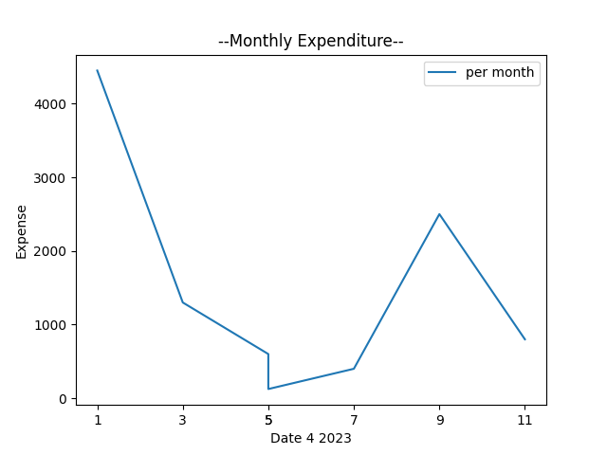


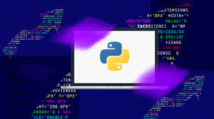

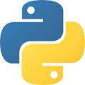
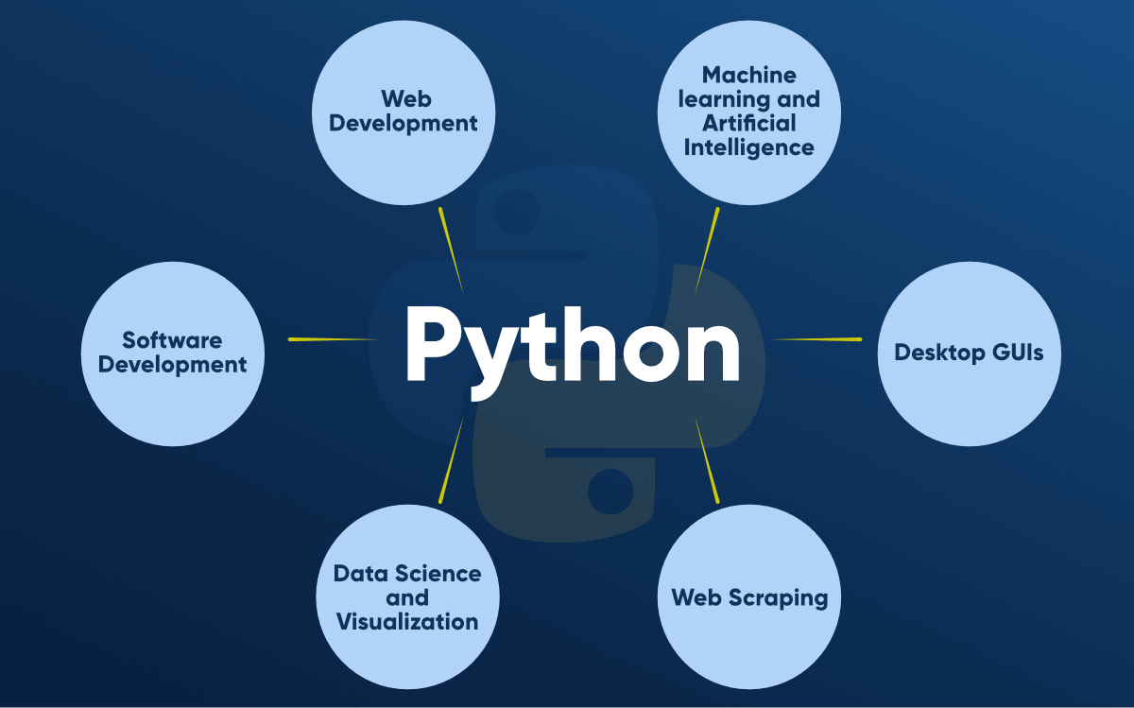
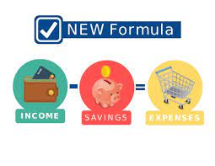
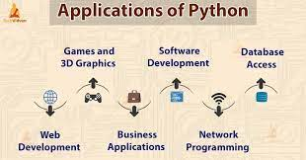

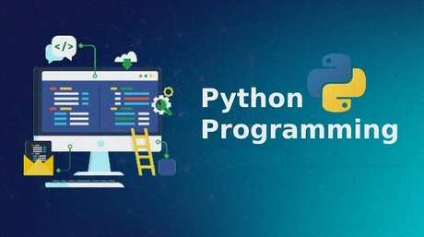

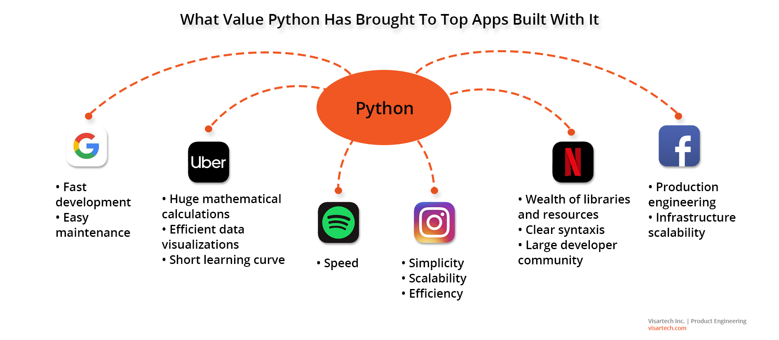
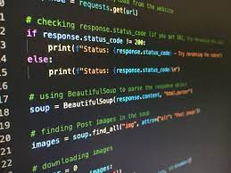
Rashtreeya Sikshana Samithi Trust
RV COLLEGE OF ENGINEERING®
(Autonomous Institution Affiliated to VTU, Belagavi-590018)
DEPARTMENT OF COMPUTER SCIENCE AND ENGINEERING
Programming with python
Harsh Kumar
1RV21CS048
About Organization
Internshala is an Indian online platform that connects students and graduates with internships and entry-level job opportunities in various fields. Founded in 2010, it has grown to become one of the largest internship platforms in India.
Internshala has partnerships with over 70,000 companies
and has helped more than 7 million students find
internships and jobs. The platform offers
internships in various fields, including engineering,
management, media, law, and more. It also has a
strong focus on promoting diversity and inclusivity
in the workplace.
Tools/Technologies Used
Python programming language
CSV module: A built-in module in Python used to read and write to CSV files.
os module: A built-in module in Python used
to interact with the operating system.
matplotlib.pyplot: A third-party library used
for data visualization and creating charts and graphs.
datetime module: A built-in module in Python used
for working with dates and times.
Problem Statement
We want to get an overview of our income, expenses, and savings for the entire period. The problem addressed by the provided code is to help users keep track of their monthly expenses by providing them
with a simple command-line tool that allows
them to add their expenses along with their
labels and dates. The tool also provides users with
insights into their monthly expenses and graphical
views of their expenses over time. Additionally, users can specify a range of dates to see a graphical representation of their expenses during that period.
Objectives
The objective of the given code is to extract and analyze data from a CSV file and display the results in a graphical format. The code reads the input CSV file, calculates the average and standard deviation of the values in the columns, and creates a bar chart and a scatter plot to represent the data visually. The objective of the analysis is to provide insights into the data and identify any trends or patterns that may be present.
Results
Applications
Python is a popular programming language with a wide range of applications in various industries. Some of the most common applications of Python include:
Web Development: Python frameworks like
Django and Flask are used to build web
applications and websites.
2.Data Science and Machine Learning:
Python's libraries like NumPy, Pandas, and
Scikit-learn are widely used for data analysis,
visualization, and machine learning applications.
3.Artificial Intelligence: Python is used in
developing AI applications like chatbots,
natural language processing, and computer vision.
4.Game Development:-Python is also used in the development of interactive games. There are libraries such as PySoy which is a 3D game engine supporting Python 3, PyGame which provides functionality and a library for game development.
Methodology & Architecture Model
The program utilizes the following technologies and tools: Python programming language, CSV file format for storing data, os and csv modules
for file handling, and matplotlib library for data visualization.
The program provides the following functionalities to the user:
Add money to the account.
Enter the data (expense) by providing the date, label, and expenditure.
View insights of the data, including the account balance, total expenditure for the month, and the percentage of expenditure relative to the income.
View a graphical representation of the monthly expenditure data.
View a graphical representation of the expenditure
data for a specified date range.
The program makes use of exception handling
to catch errors and provide helpful error messages to the user.
The program provides a simple user interface
by displaying a menu of options and prompting the user for input.
Take Away
Basic Python programming, Object-Oriented Programming,
Connecting pyrhon with database, Creating GUI with python using pyqt
References
Python documentation :for understanding libraries
Real Python: https://realpython.com/
Stack Overflow: https://stackoverflow.com/
Acknowledgements
Gratefully acknowledge “Internshala” for their invaluable contributions to this poster. Their guidance and support were crucial in shaping its content and design. Thank you all for your assistance.
Contact Information :
E-mail: harshkumar.cs21@rvce.edu.in

